Slide 1
OpenFOAM GUI Application Development
Thaw Tar
2022/9/17

Slide 2
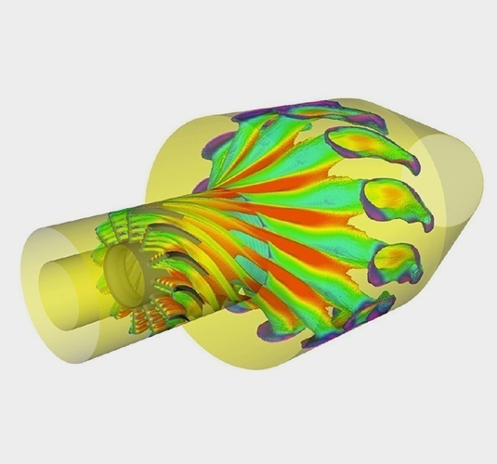
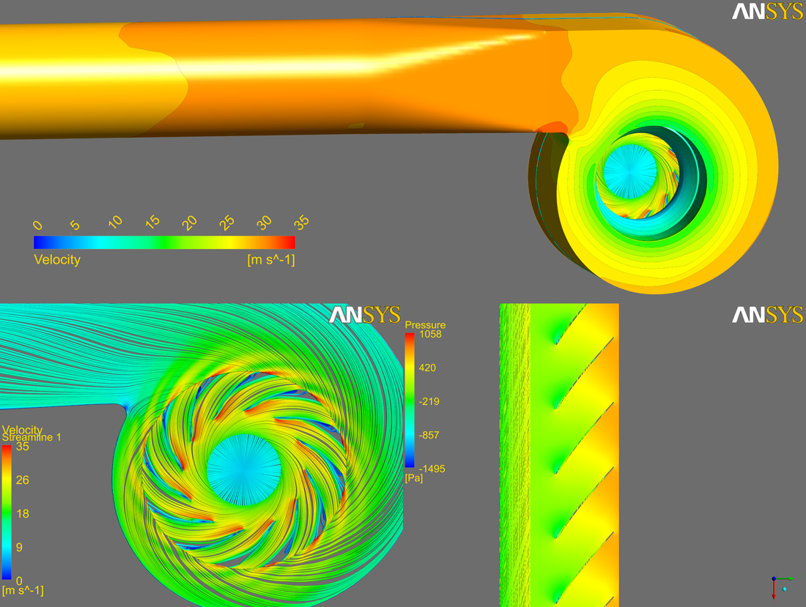
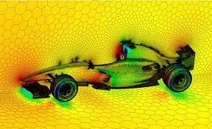
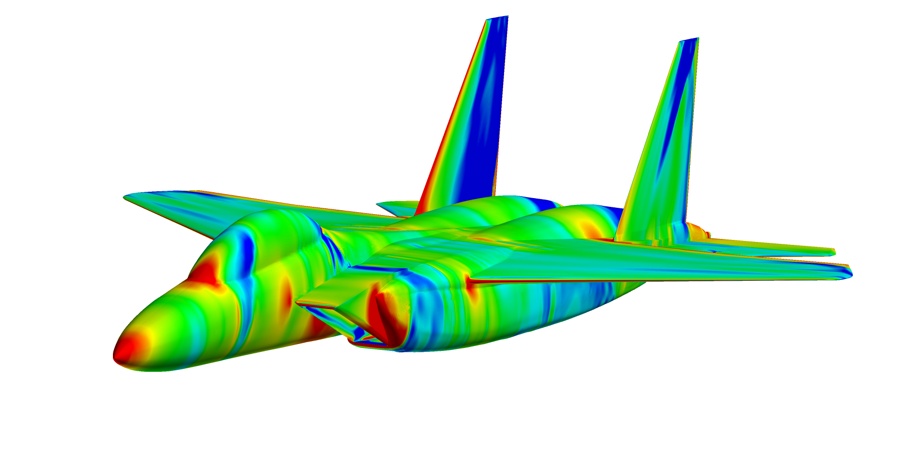
What is Computational Fluid Dynamics (CFD)

Slide 4
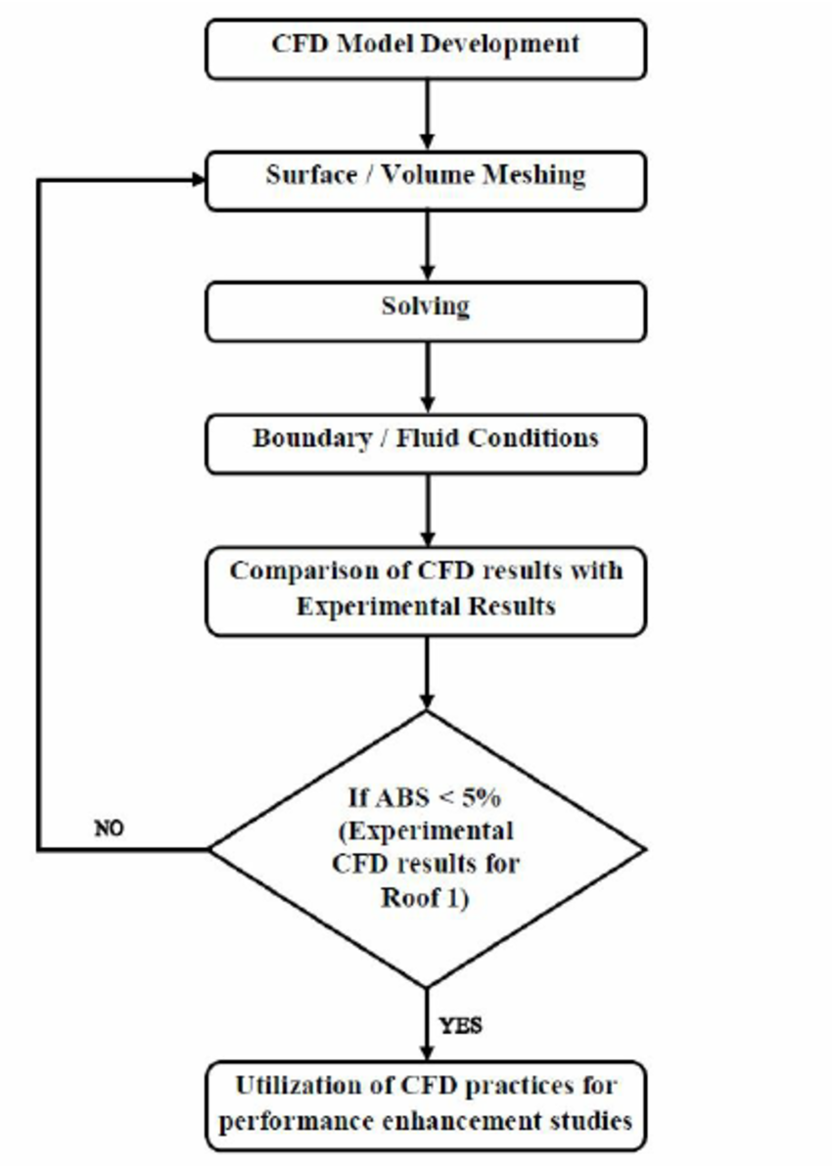
CFD Simulation Process

Slide 5
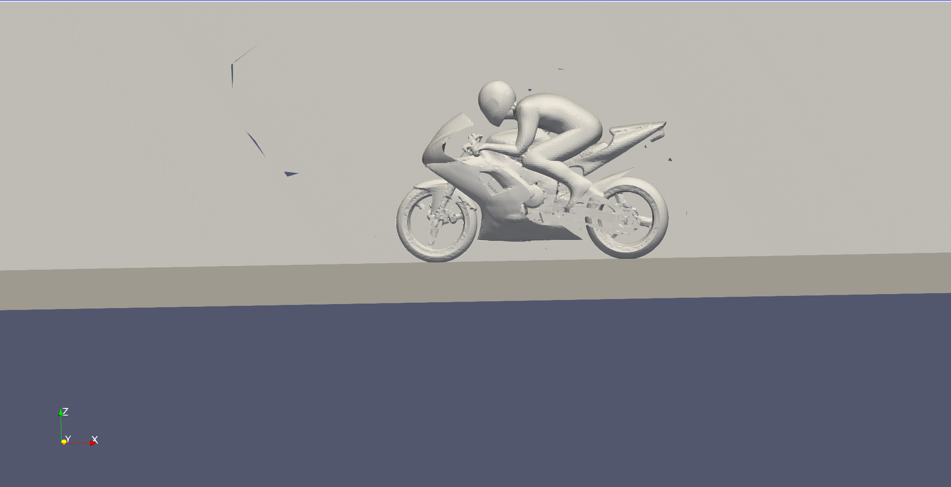
Pre-processing (Geometry Creation)

Slide 6
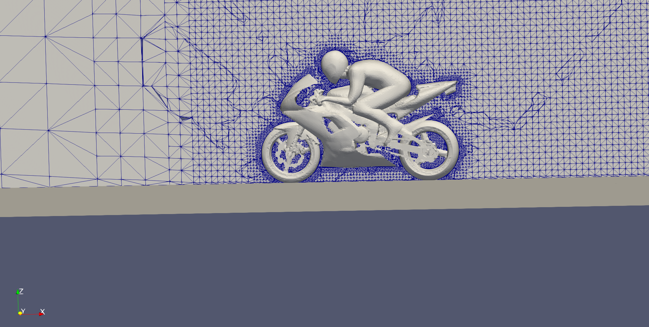
Pre-processing (Mesh Generation)

Slide 7
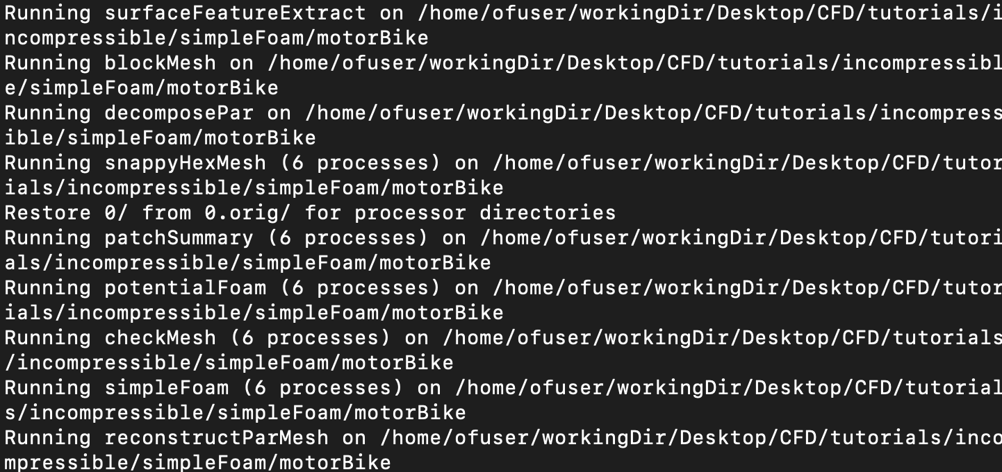
Solving

Slide 8
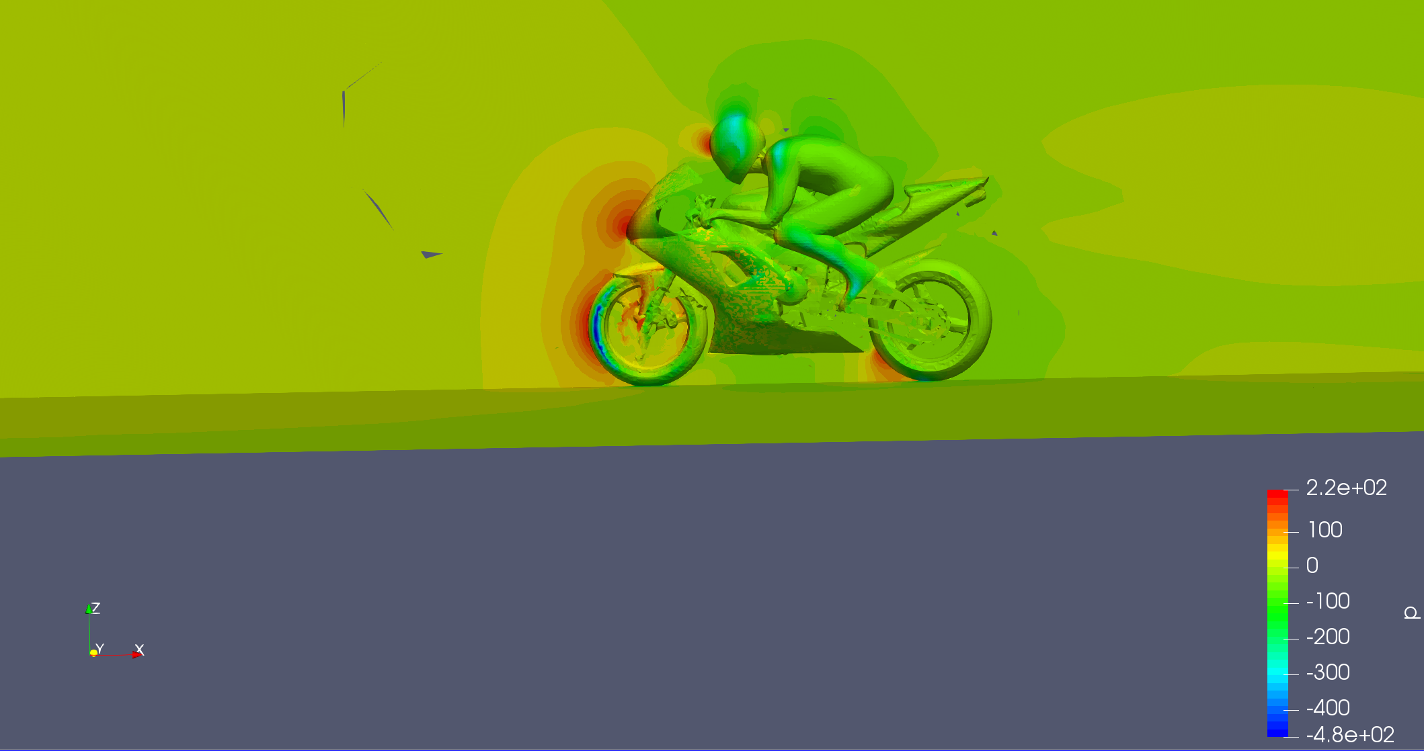
Post-processing

Slide 9

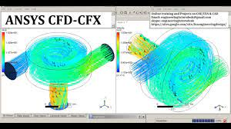
Major software brands in CFD
https://www.youtube.com/watch?v=YcwxtgScrac

Slide 10
What is OpenFOAM?
Most widely used Open-Source CFD code in the world!
More used in Universities than Companies

Slide 11
Problems with OpenFOAM
There is no GUI!!!
All inputs are in dictionary files.
Hard to learn.
Post processing is difficult

Slide 12
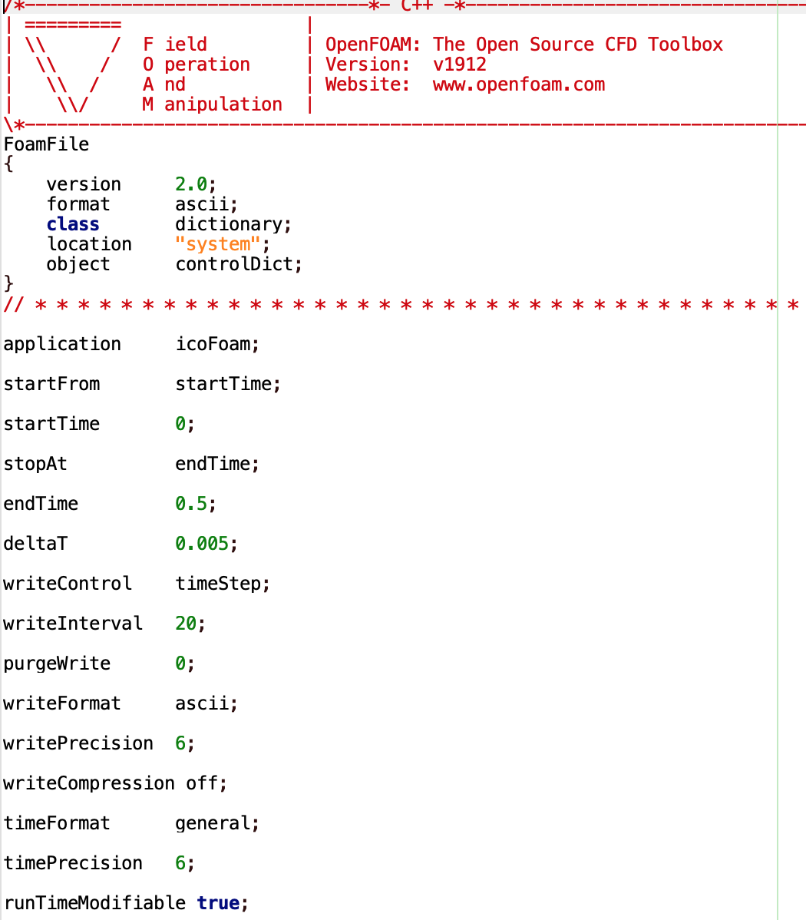
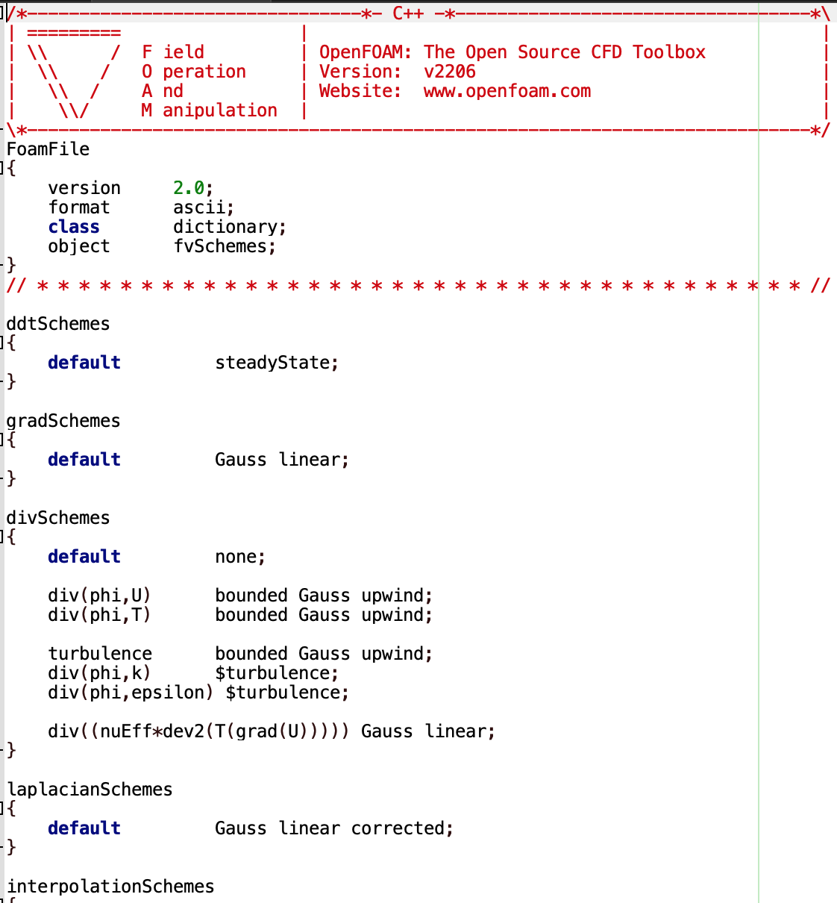
Example of OpenFOAM dictionary file

Slide 13
Established Products in OpenFOAM GUI
HELYX (Standalone software)
https://www.youtube.com/watch?v=HsJTdXeEGyQ
Dicehub (Web application + Cloud computing)
https://dicehub.com/community/4190
Simscale (Web application + Cloud computing)

Slide 14
foamAuto (Current stage and idea)
Developed some command line backend codes in C++ to generate dictionary files.
Wrote a few codes for GUI. Depends heavily on Python version, etc.

Slide 15
Which Programming Language?
Python (Tkinter, PyQt, numpy, scipy, OpenCASCADE)
C++ (Qt, OpenCASCADE)
C# (.NET Framework)
Java (Native GUI of Java although ugly)

Slide 16
Python packages to use
Tkinter (BSD) or PyQt (GPL3.0 or Commercial)
OpenCASCADE (GPL 3.0)
Numpy (BSD), Matplotlib (BSD), Scipy (BSD)
YAML (MIT) or JSON (BSD)
GPL : GNU Public License (You must give out the code)
LGPL: Lesser GPL (You may not give out the code)
BSD, MIT: You may not give out the code

Slide 17
Business model
Standalone software package with support (Like Helyx)
Web Saas (Like Dicehub and Simscale)
Give out everything and just give training (OpenFOAM style)

